Slide 1
Week 8
Spatial Clustering, Geodemographic Analysis, and Regionalization

Slide 2
Today’s Agenda
Clustering along space AND non-spatial attributes
Geodemographics
Regions and regionalization

Slide 3
Geodemographics
We have currently only used clustering for purely spatial attributes

Slide 4
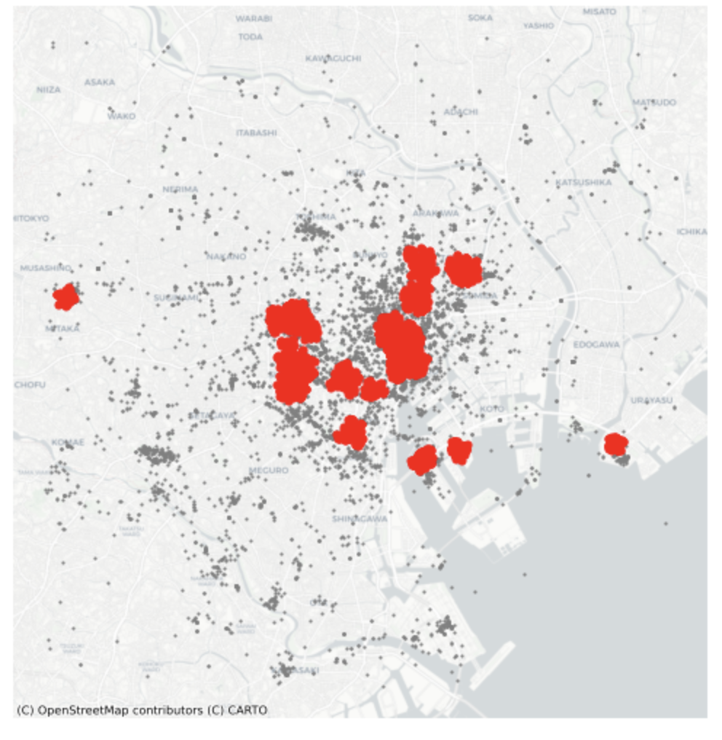
Geodemographics
We have currently only used clustering for purely spatial attributes
Recall our use of DBSCAN in the week on point pattern analysis

Slide 5
Geodemographics
We have currently only used clustering for purely spatial attributes
Recall our use of DBSCAN in the week on point pattern analysis
Can we incorporate other attributes in our feature matrix?

Slide 6
Geodemographics
Imagine in this dataset of geotagged photos, we also have information on the type of place photographed, it’s price range, etc.

Slide 7
Geodemographics
Imagine in this dataset of geotagged photos, we also have information on the type of place photographed, it’s price range, etc.
What if we created clusters based on those characteristics instead of spatial ones?
Would the new clusters be different than these?

Slide 8
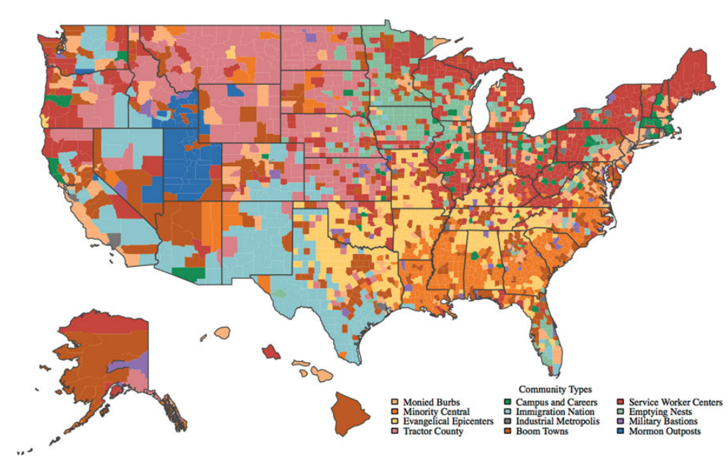
From Singleton, A. D., & Spielman, S. E. (2014). The past, present, and future of geodemographic research in the United States and United Kingdom. The Professional Geographer, 66(4), 558-567.

Slide 9
Geodemographics
Geodemographic clustering can be a powerful way to create groups and “profiles” based on certain attributes.

Slide 10
Note: Membership within each of these clusters are not spatially connected. Actually, there were no spatial constraints in this clustering!
From Singleton, A. D., & Spielman, S. E. (2014). The past, present, and future of geodemographic research in the United States and United Kingdom. The Professional Geographer, 66(4), 558-567.

Slide 11
Regions and Regionalization
Sometimes, we want to find spatially connected clusters that also share commonalities in non-spatial attributes.

Slide 12
Regions and Regionalization
Sometimes, we want to find spatially connected clusters that also share commonalities in non-spatial attributes.
For ex, for finding communities or neighborhoods, or other areas for which we need to draw boundaries.

Slide 13
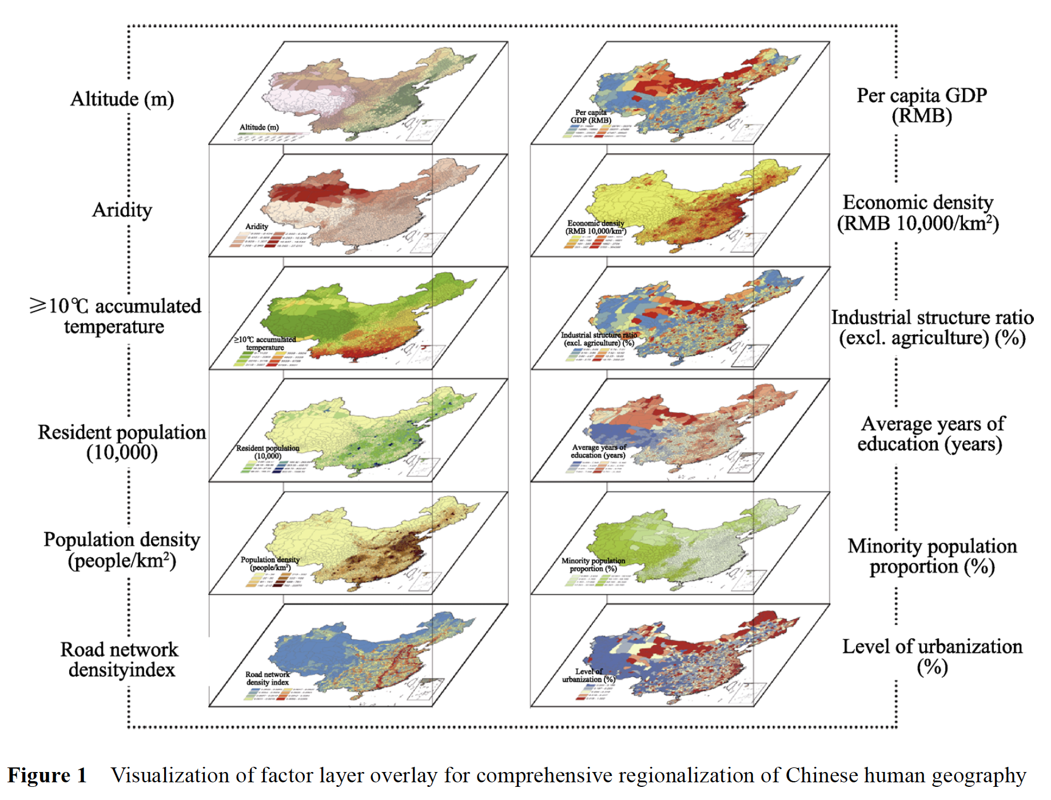
From Fang, C., Liu, H., Luo, K., & Yu, X. (2017). Process and proposal for comprehensive regionalization of Chinese human geography. Journal of Geographical Sciences, 27, 1155-1168.

Slide 14
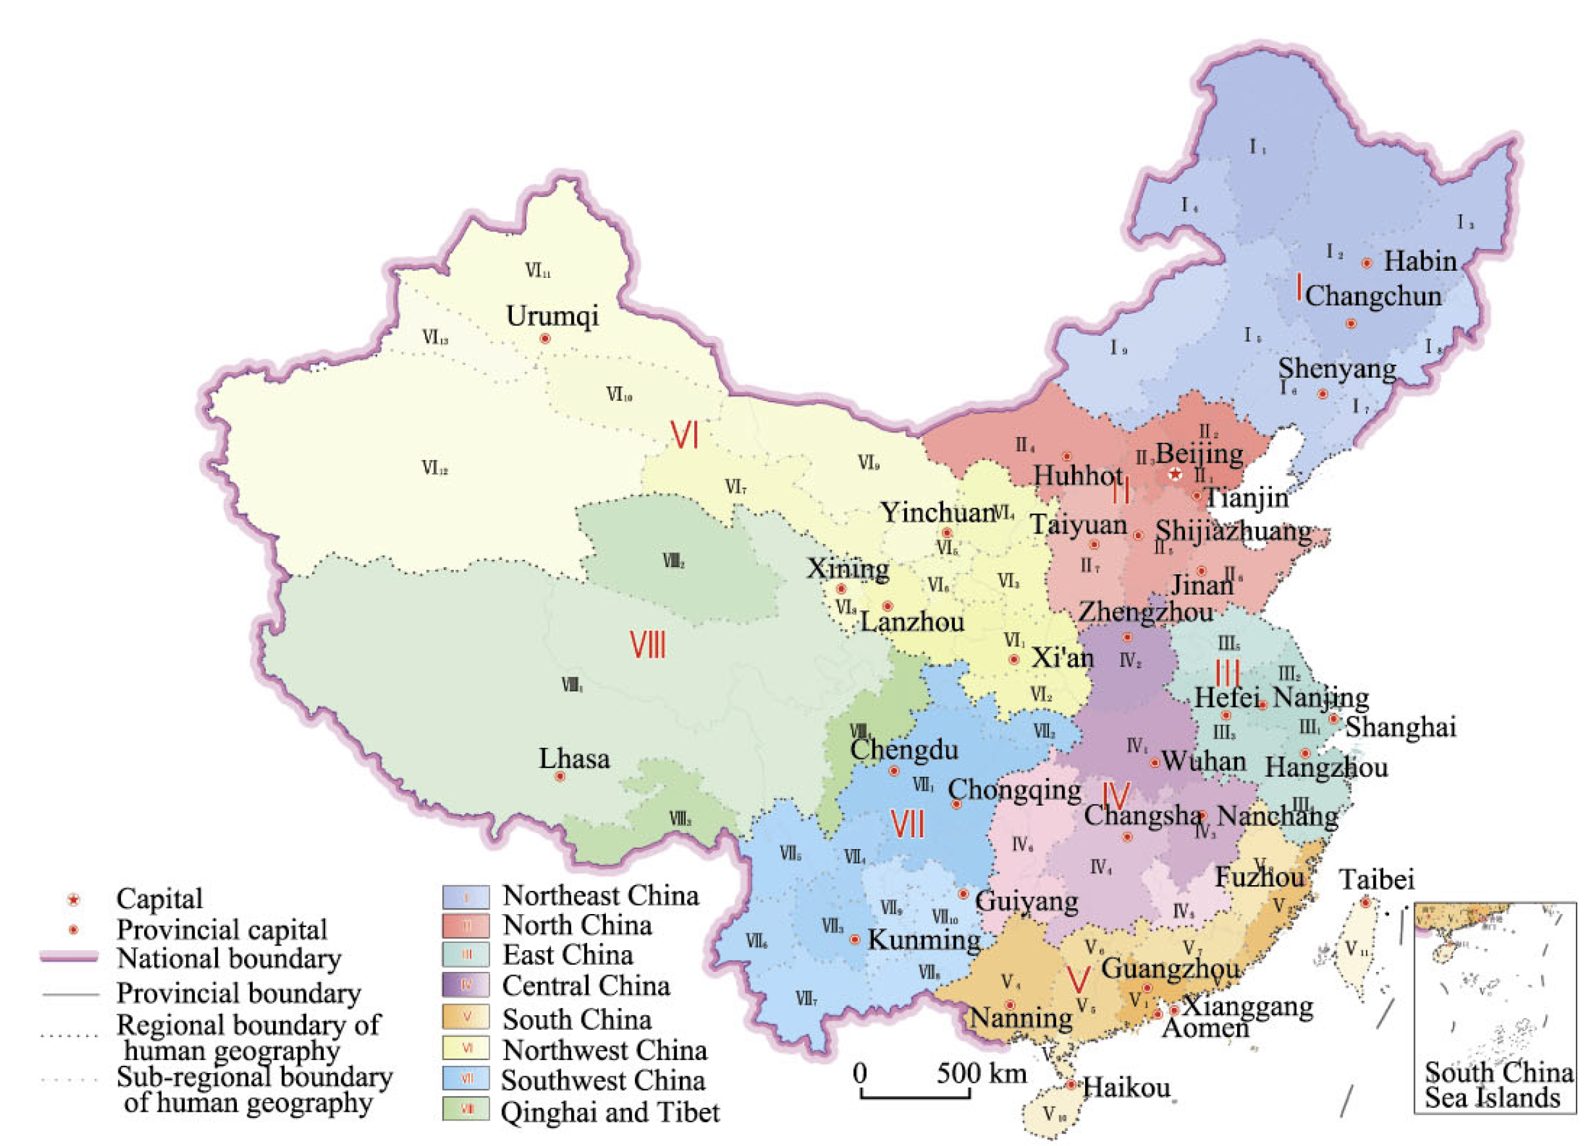
(Ignore the slight variations in colors within each group here)
From Fang, C., Liu, H., Luo, K., & Yu, X. (2017). Process and proposal for comprehensive regionalization of Chinese human geography. Journal of Geographical Sciences, 27, 1155-1168.

Slide 15
Regions and Regionalization
Practically, in sklearn, we use a “connectivity constraint” based on our spatial weights (typically the binary ones like queen, rook, or k-nearest neighbors).

